Slide 1
Hospital Management System with Chatbot

Slide 2
Abstract
These bots connect with potential patients visiting the site, helping them discover specialists, booking their appointments, and getting them access to the correct treatment.
In any case, the utilization of artificial intelligence in an industry where individuals’ lives could be in question, still starts misgivings in individuals. It brings up issues about whether the task mentioned above ought to be assigned to human staff.
This healthcare chatbot system will help hospitals to provide healthcare support online 24 x 7, it answers deep as well as general questions. It also helps to generate leads and automatically delivers the information of leads to sales. By asking the questions in series it helps patients by guiding what exactly he/she is looking for.

Slide 3
INTRODUCTION
Computers give us information; they engage us and help us in a lot of manners. A chatbot is a program intended to counterfeit smart communication on a text or speech. Yet, this paper concentrates only on text.
The response to the question will be replied based on the user query and knowledge base. The significant keywords are fetched from the sentence and answer to those sentences. If the match is discovered or the significant, answer will be given or similar answers will be displayed

Slide 4
Modules
Admin:
admin can login to application by using username and password as ‘admin’ and then add new doctor details and give login details to all doctors. Admin will record all in-patient details and give ID to each patient. Admin will view all investigations and prescription given by doctor and can give details on insurance

Slide 5
Doctor
Doctor can login to application and then view in-patient details and then generate prescription and then update time table, online appointments and scheduled meetings.

Slide 6
Patient
patient can login to application by using patient ID and can view own prescription and can view doctor time table, meeting time and online appointment time and can chat with chatbot

Slide 7
Hardware Requirement
i3 Processor Based Computer or higher
Memory: 1 GB
Hard Drive: 50 GB

Slide 8
Software Requirements
Windows 7 or higher
Python
Django
My SQL 5.5
Google Chrome Browser

Slide 9
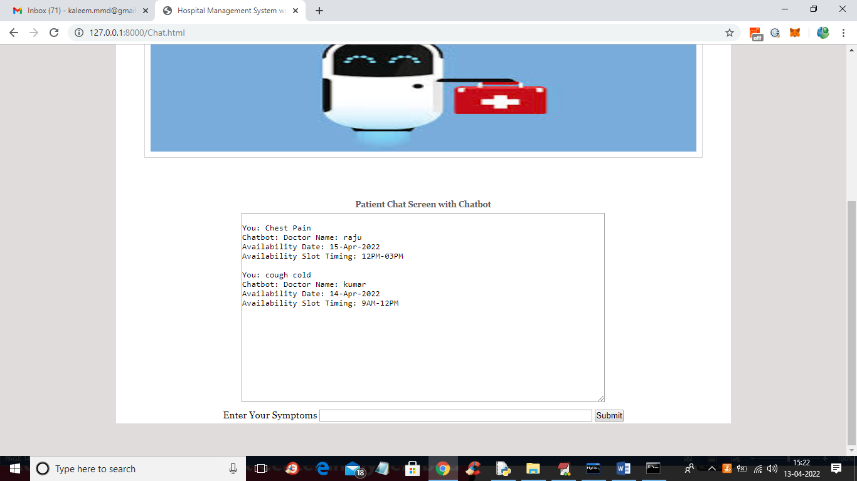
Output

